Slide 1
AGHOSH
COMPLEX
Presenter:
Col. Mubashir Iqbal (R)
Director Aghosh Complex

Slide 2
AGHOSH ORPHAN CARE HOMES
EDUCATION BASED ORPHANAGE
PLAY GP TO POST GRADUATE
260 BOYS & GIRLS
IDEAL LIVING ENVIRONMENTS
PLAY AREAS AND OUTDOOR SPORTS
LIBRARY, COMPUTER LABS, AUDITORIUM
EMOTIONAL AND PSYCHLOGICAL SUPPORT
CAREER PLANNING
TECHNICAL EDUCATION

Slide 3
DEPARTMENTS OF AGHOSH COMPLEX
There are four departments of Aghosh Complex:
Aghosh Orphan Care Home
Aghosh Grammar Higher Secondary School (Boys & Girls)
Minhaj Institute of Qir’at & Tehfeez ul Quran
Aghosh Academy (Science & Arts)

Slide 4
Financial support/Sponorship
Education and Scholarship programs:
Healthcare facilities:
Food and nutrition:
Shelter and infrastructure:
Emotional and psychological support:
Vocational training programs:
Recreational activities:
Community involvement:
Long-term commitment:

Slide 5
AGHOSH
Orphan Care Home

Slide 6
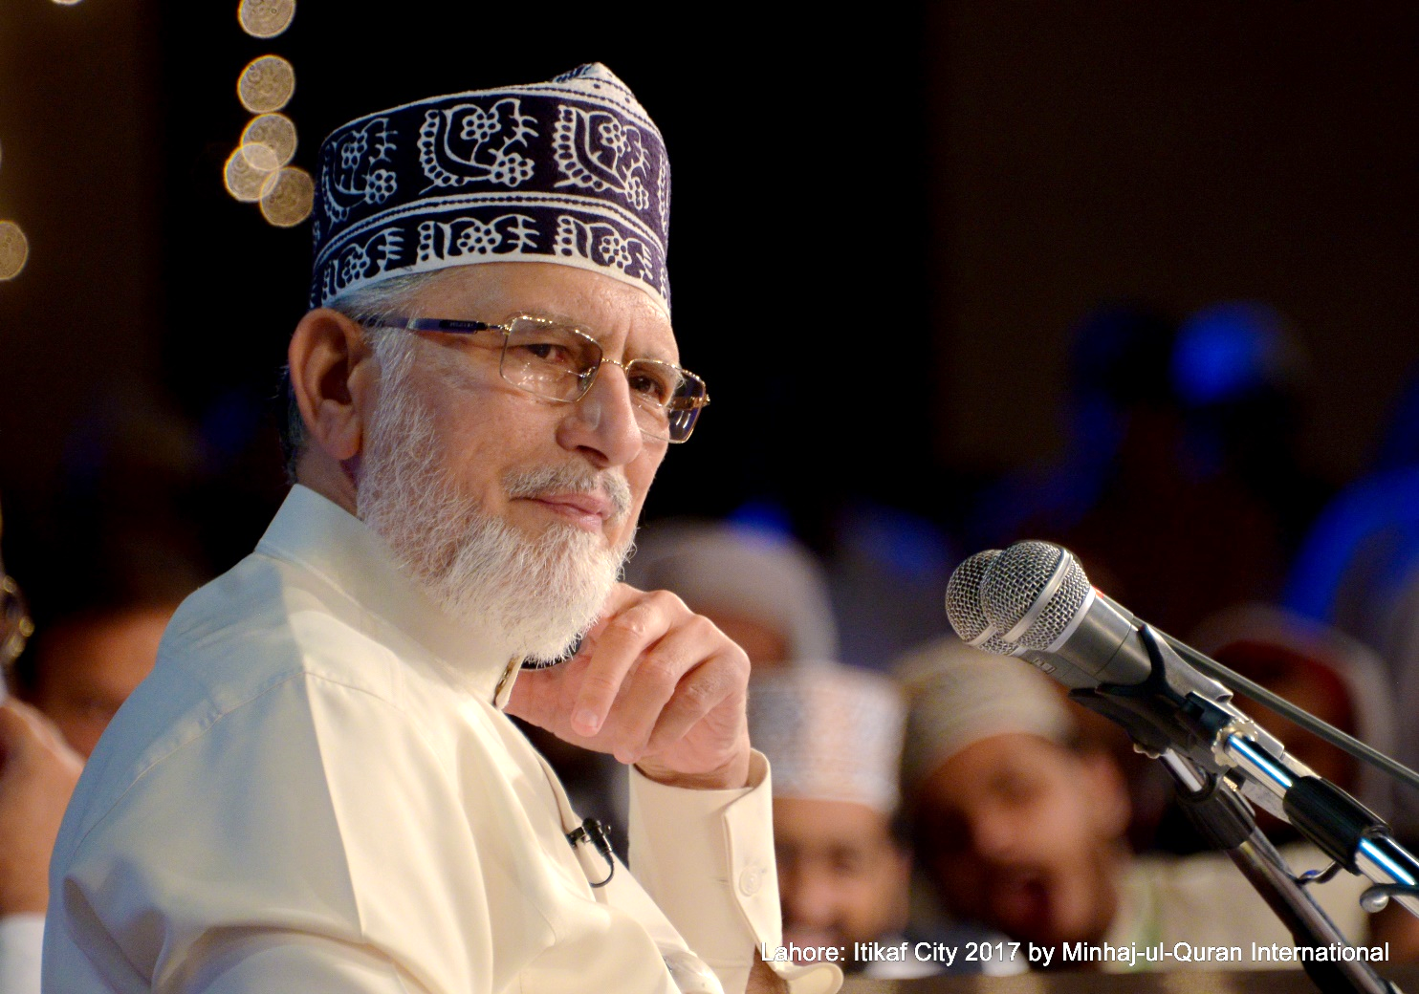
OUR MENTOR

Slide 7
MISSION
STATEMENT
"At the Heart of Hope Aghosh Orphan Care Home, we are driven by an unwavering commitment to provide orphaned children with a nurturing environment, high-standard living conditions, and an exceptional education, empowering them to flourish into confident, compassionate, and capable individuals.At Aghosh Management, we offer a seamless continuum of educational institutions, ranging from early childhood playgroups to advanced doctoral programs. Our fundamental mission is to sculpt raw students into polished, proficient, and highly productive citizens, contributing to the prosperity and progress of Pakistan.

Slide 8
CAMPUSES
Lahore 260 Boys & Girls (Boarding)
Karachi 50 Boys (Boarding)
Sialkot 160 Boys & Girls (Day Scholars)
Jhelum 10 Boys (Boarding)
Aghosh Village 2000 boys & girls

Slide 9
INTAKE CRITERIA
Categories
Orphan (80%) An orphan child is a minor (a person under the legal age of adulthood) who has lost one or both parents due to various circumstances, including death or abandonment
Miskeen (20%) the inability of the parents to provide care and support.
Age Limit
3 to 11 Years( Boys) "The age eligibility for admission to our orphanage is set between 3 and 11 years. This age range is chosen with consideration for language development and the ease of providing effective training and support within our orphan care home."
9 to 15 Years (Girls)
*1 child per family (Preferably but can be adjusted on compassionate reasons)

Slide 10
DOCUMENTATION
Death Certificate (Issued by NADRA)
School Leaving Certificate
Medical Certificate (For Disabled Guardian)
Form B
Verification Certificate
Undertaking
CNIC (Guardian)
Photographs

Slide 11
FACILITIES
For Aghoshian Students

Slide 12
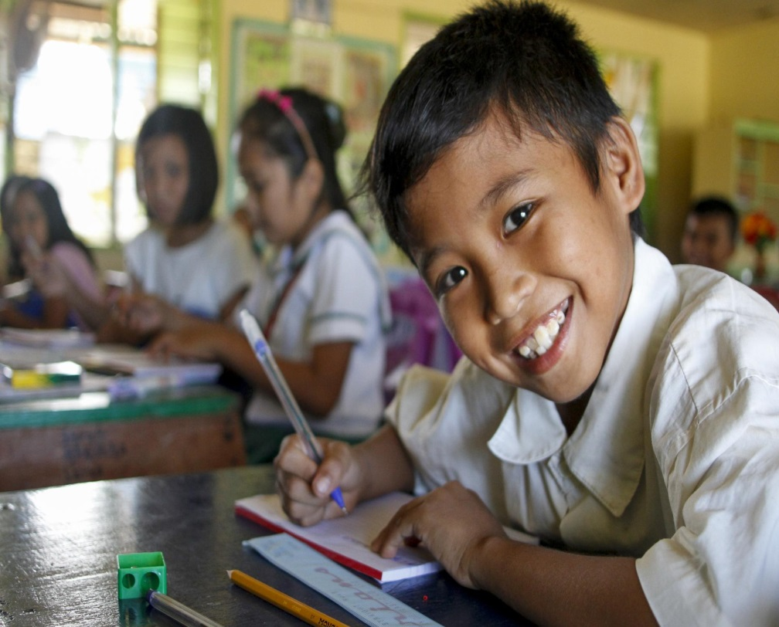
EDUCATION
Play Gp To Post Graduate Level
Technical/ Vocational
All educational support
Extra Coaching
Professional Academy

Slide 13
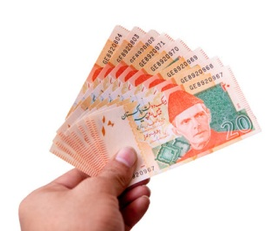
Pocket Money
Financial Education
Independence and Responsibility
Ownership and Empowerment
Reward System
Social Integration
Understanding Value
Preparing for Adulthood

Slide 14
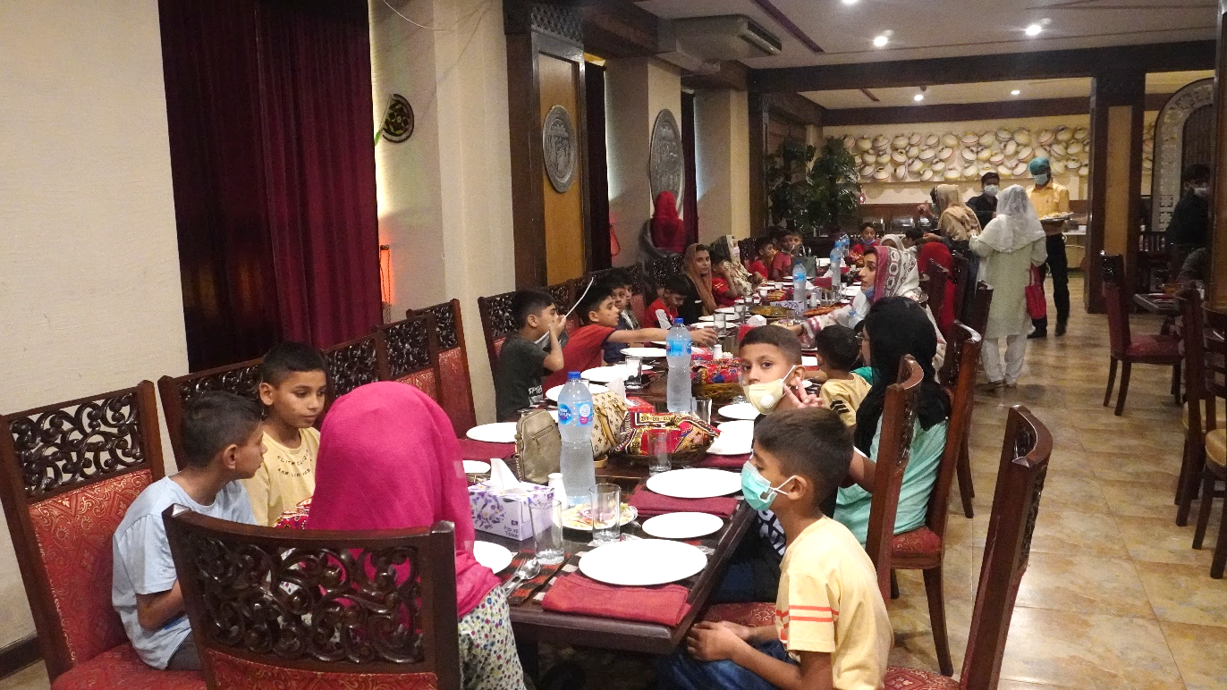
Provision of Food
Balanced Diet
Menu
Mess Committee
Dinner Nights
Complaint Register

Slide 15
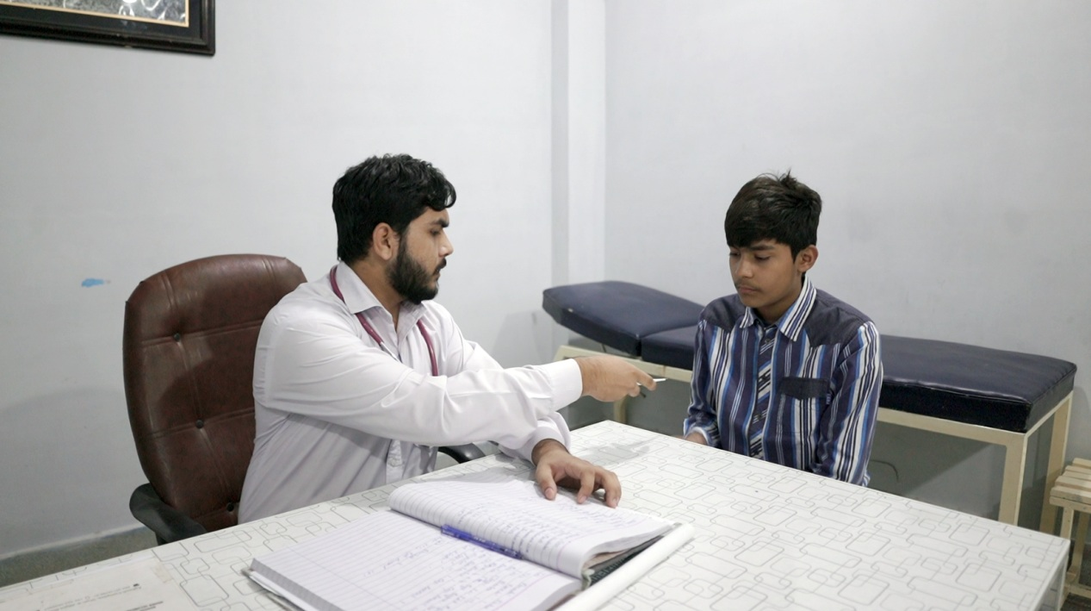
MEDICAL
Dispensary
Ambulance
Routine Medicines
Doctor’s Visit
Hospitalization
Expenses

Slide 16
We are family Forever &
We shall leave you never

Slide 17
GENERAL
Comprehensive Care
Career Counselling
Playgroup to Postgraduate
16 year of Education is sealing
Job Placement
Marriages platform for Girls
Professional Education
A Future of Possibilities

Slide 18
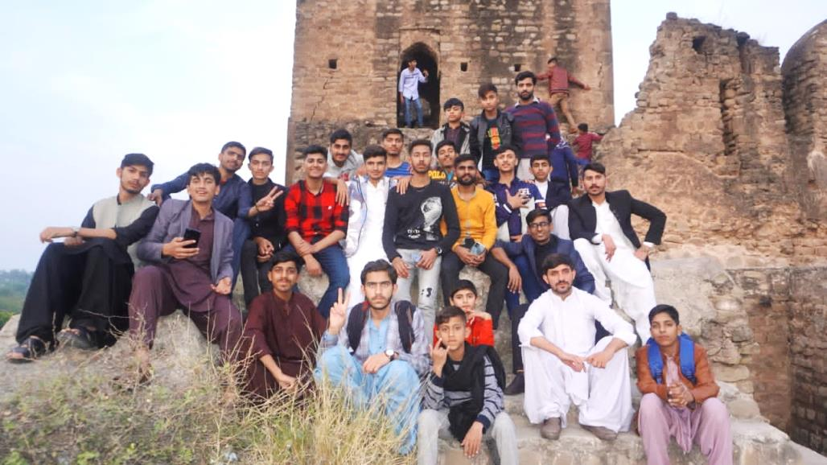
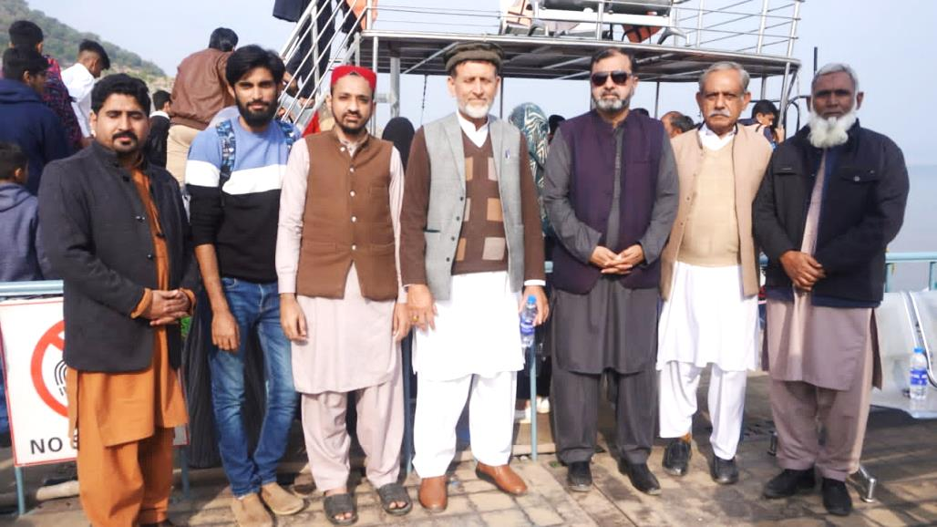
RECREATIONAL ACTIVITIES

Slide 19
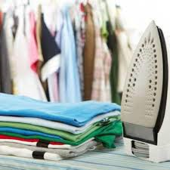
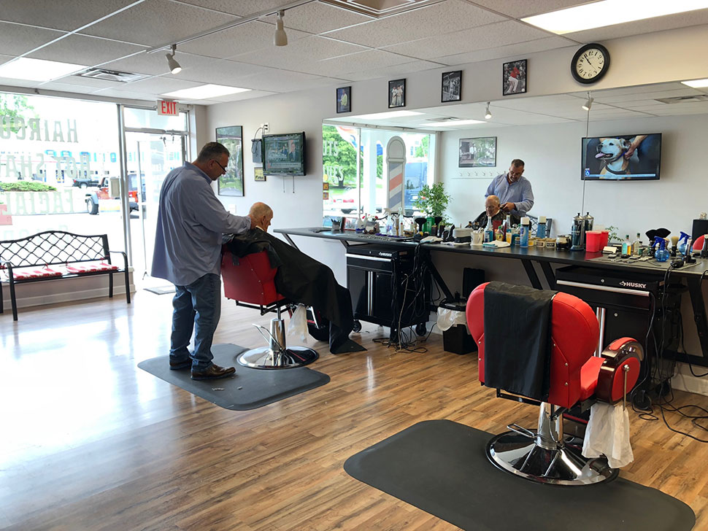
WASHERMAN & BARBER SHOP

Slide 20
GENERATOR BACKUP

Slide 21
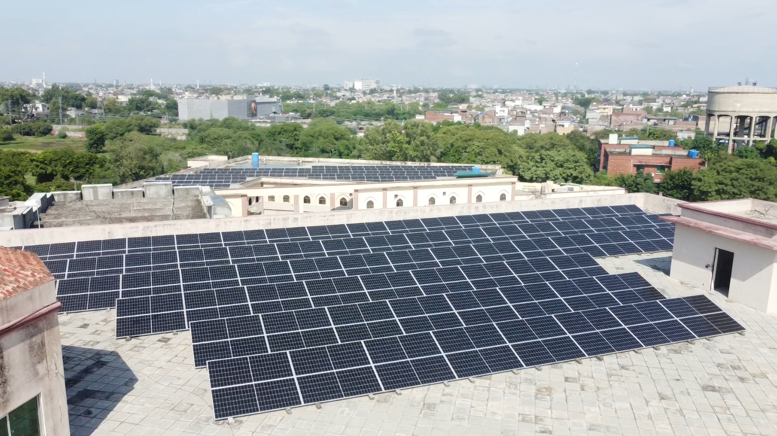
SOLAR SYSTEM

Slide 22
CHALLENGES
Language and Cultural Diversity:
Educational Gaps:.
Psychological Trauma:
Limited Resources
Social Stigma:
Physical and Emotional Well-being:
Staff Training and Retention:.
Preparation for Independent Living:
Parental Involvement:
Support from Government

Slide 23
MOTHER’S AREA
A Special Place: The "Mother's Area" is a unique space for our younger children aged 3 to 10.
Dedicated Mothers: Each mother is assigned to a group of 8 children, providing personal care and guidance.
A Home Within a Home: Children reside in comfortable 3-bedroom flats, creating a family-like setting.
Nurturing Bonds: Our mothers care for these children as their own, creating strong, lifelong connections.
A Safe Haven: The "Mother's Area" offers a warm and loving environment where children thrive.

Slide 24
POLICIES
Child protection Policy
Food Policy
Discipline policy
Education Policy
Healthcare
Security Policy
Administrative Policy
Admission Policy

Slide 25
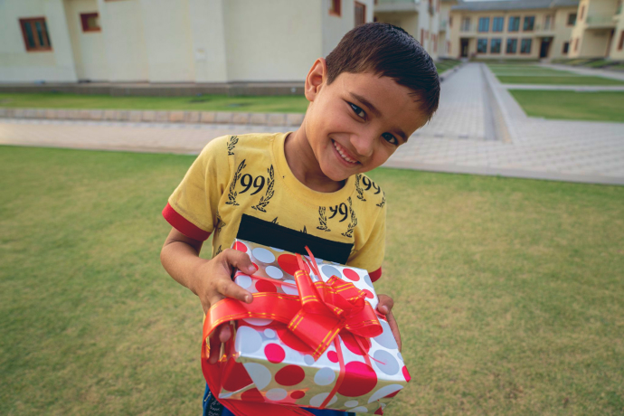
SPONSOR AN ORPHAN CHILD

Slide 26
SPONSORSHIP
Complete sponsorship (Rs 18000 (65 $) per child)
We accept Sadqat, Zaqat, Atiyat
Donation in Kind
Donation in Cash
Provision of food items, sports etc.
Sponsor a child to study abroad

Slide 27
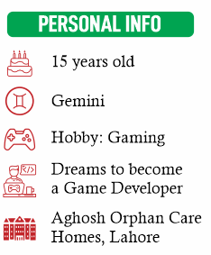
SPONSOR USMAN GHANI
Change Usman’s Life with
PKR 18,000/month

Slide 28
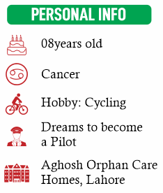
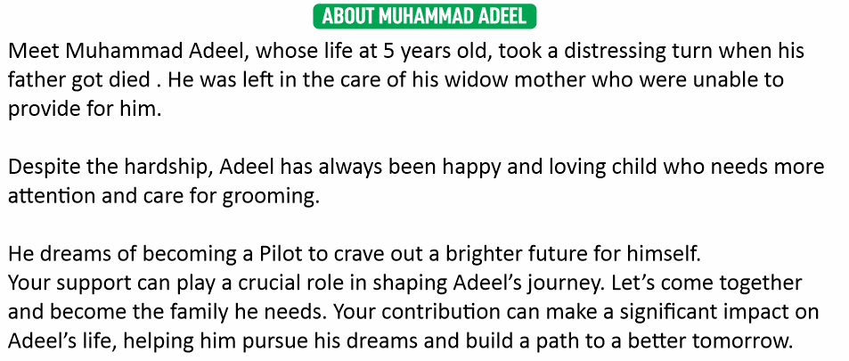
SPONSOR M. ADEEL
Change Adeel’s Life with
PKR 18,000/month

Slide 29
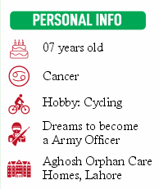
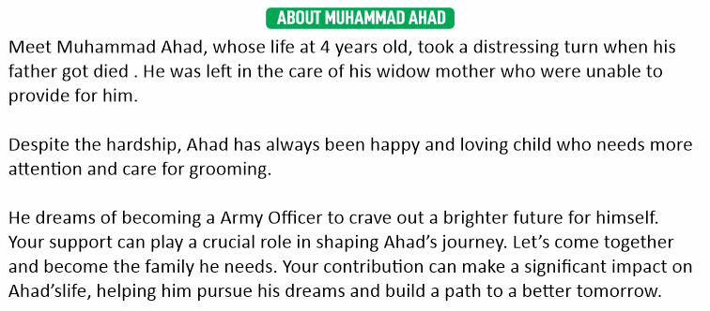
SPONSOR M. AHAD
Change Ahad’s Life with
PKR 18,000/month

Slide 30
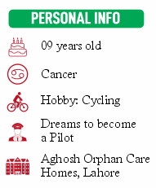
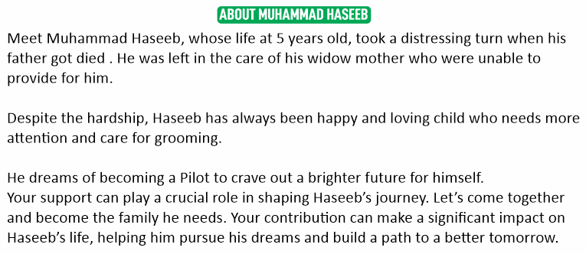
SPONSOR M. HASEEB
Change Haseeb’s Life with
PKR 18,000/month

Slide 31
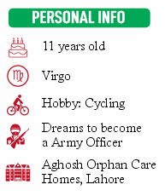
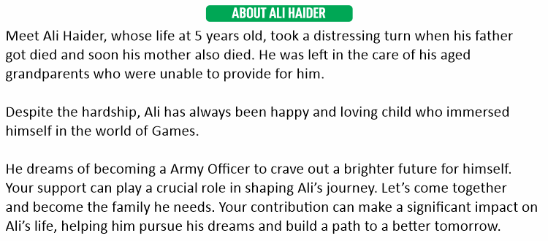
SPONSOR ALI HAIDER
Change Ali’s Life with
PKR 18,000/month

Slide 32
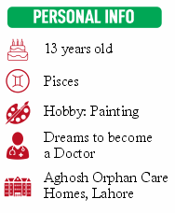
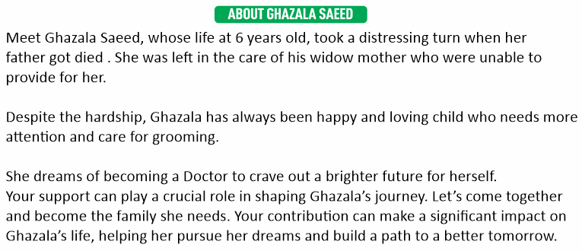
SPONSOR GHAZALA SAEED
Change Ghazala’s Life with
PKR 18,000/month

Slide 33
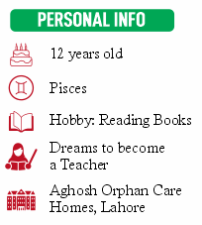
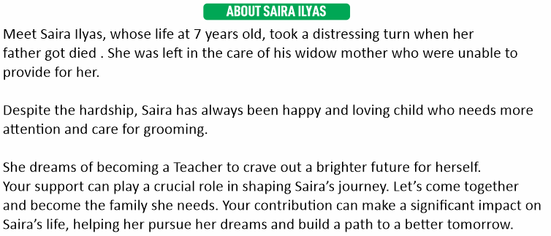
SPONSOR SAIRA ILYAS
Change Saira’s Life with
PKR 18,000/month

Slide 34
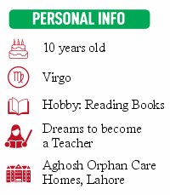
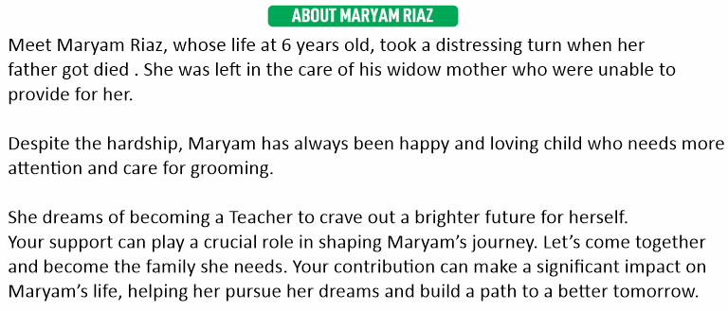
SPONSOR MARYAM RIAZ
Change Maryam’s Life with
PKR 18,000/month

Slide 35
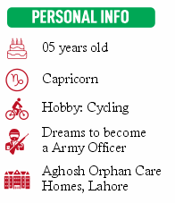
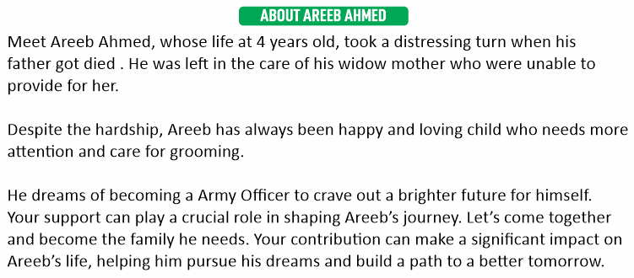
SPONSOR AREEB AHMED
Change Areeb’s Life with
PKR 18,000/month

Slide 36
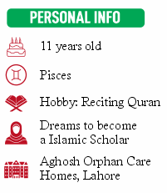
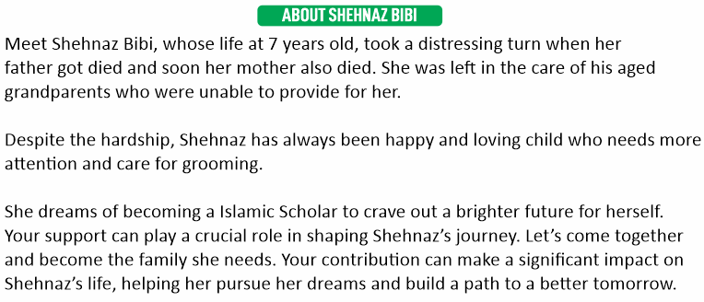
SPONSOR SHEHNAZ BIBI
Change Shehnaz’s Life with
PKR 18,000/month

Slide 37
MEAT REQUIREMENT
Sr. | Head | Amount (1 Time Meal) | Amount (4 Meals a Month)
1. | Beaf Mince (35 KG) @ 900 | 31,500.00 | 126,000.00
2. | Meat for Pulao (45 KG) @ 800 | 36,000.00 | 144,000.00
3. | Meat for Qorma (50 KG) @ 800 | 40,000.00 | 160,000.00
Total |  | 107,500.00 | 430,000.00

Slide 38
Thanks A Lot For Your Valuable Time

Slide 40
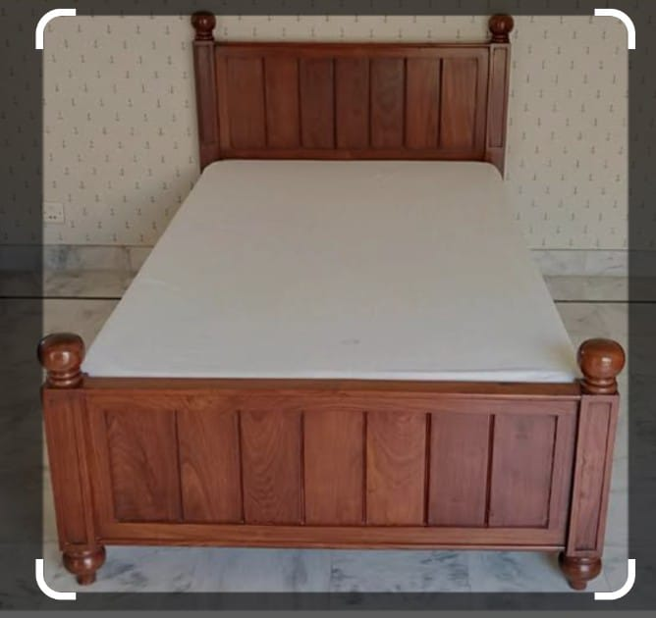
BEDS REQUIRED FOR ORPHANS
ESTMATED PRICE WITH MATTRESS (40,000)

Slide 41
SPONSORSHIP
Complete sponsorship:
Rs 15000 ~ 18000 per child / per month
We accept Sadqat, Zaqat, Atiyat
Donation in Kind
Donation in Cash
Provision of food items, sports etc.
Sponsor a child to study abroad

Slide 42
EXPENSE DETAIL(26700)
Food 15000
Education 5000
Health Care 1500
Pocket Money 1000
Recreational Trips 1000
Maintenance/ Staff pay Share 800
Marriages support 500
Development of Complex -
Utility Bills 900
Sports/Extracurricular activities 500
Provision of cloths/shoes/blankets 500

